Slide 1
Cryptocurrency Prediction using Social Media Volume
Spring 2019 | Data engineering platforms for analytics
GROUP 5 – Akarsh sahu, nazih kalo, angela teng, sowmya Nallapaneni
Notes:
How we cleaned and normalzied data

Slide 2

Outline
Executive Summary
Business Use Case
Tech Stack – Data and Tools
Design Considerations
Enhanced Entity Relationship Model
Dimensional Model
Visualizations and Demo
Future Recommendations

Slide 3
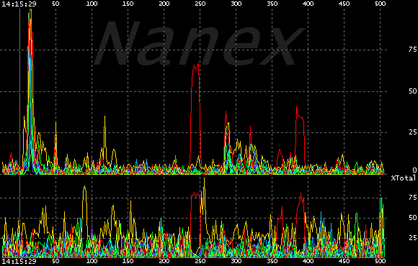

Executive Summary
Background:
The cryptocurrency market is very nascent and volatile. This makes the asset class very risky but also potentially lucrative.
Understanding the impact of social media on price direction can provide a cryptocurrency trader a better trading strategy.
Objective: To collect market information and social media engagement data for the major cryptocurrencies and tokens to create a platform for short-term trading strategy.
Notes:
- trading strategy
- platform
Background:
Objective: To collect market information and social media engagement data for the major cryptocurrencies and tokens to create a platform for trading analysis.
Strategy:
*Scope:

Slide 4
Executive Summary
Project Background
Objective
Future Recommendations
Automated Data Integration Connect Data Sources, Ingestion, and Consolidation
Efficient and Scalable Data Storage: Normalized EER Model,OLAP Dimensional Model,and Cloud SQL Integration
Leverage NLP and Sentiment Analysis
Build a real-time predictive model utilizing all the metrcs , sentiment, and demography.
Build a regression model based on metrics available to test the hypothesis further.
The cryptocurrency market is very volatile.
Understanding the impact of social media on price direction can provide a cryptocurrency trader a better trading strategy.
Generate real-time insights on cryptocurrency price: Leveraging Data Visualization, Statistical Analyses, and Forecasting.
Notes:
- trading strategy
- platform
Background:
Objective: To collect market information and social media engagement data for the major cryptocurrencies and tokens to create a platform for trading analysis.
Strategy:
*Scope:
his makes the asset class very risky but also potentially lucrative.
Future Recommendations:
There is a strong correlation b/w social media indicators and cryptocurrency price direction.
to generate sentiments from the text sources(Tweets, Reddit Posts, etc.)

Slide 5
Executive Summary
Project Background/Hypothesis
Project Objective
Conclusion/Future Recommendations
Efficient and Scalable Data Storage: Normalized EER Model, OLAP Dimensional Model, and Cloud SQL Integration
Strong Correlation b/w Cryptocurrency price and Social media indicators. But Correlation doesn’t imply causation!
Build a real-time predictive model utilizing all the metrics , sentiment, and demographics.
The cryptocurrency market is very nascent and volatile. This makes the asset class very risky but also potentially lucrative.
Hypothesis: Social media indicators are strongly correlated with prices and can be a good prediction indicator for short-term investments in cryptocurrencies
Generate real-time insights on cryptocurrency price: Leveraging Data Visualization, Statistical Analyses, and Forecasting.
Leverage NLP and Sentiment Analysis to generate sentiments from text sources.
Build a regression model based on metrics available to test the hypothesis further.
Automated Data Integration Connect Data Sources, Ingestion, and Consolidation
Behavioral sciences and related scientific literature provide evidence that there is a close relationship between social media and price fluctuations of cryptocurrencies.
Notes:
- trading strategy
- platform
Background:
Objective: To collect market information and social media engagement data for the major cryptocurrencies and tokens to create a platform for trading analysis.
Strategy:
*Scope:
his makes the asset class very risky but also potentially lucrative.
Future Recommendations:
There is a strong correlation b/w social media indicators and cryptocurrency price direction.
to generate sentiments from the text sources(Tweets, Reddit Posts, etc.)

Slide 6

Business Use Case
Goal: Create a price prediction database based on metrics from multiple online resources and incorporate it into larger system that automatically and intelligently manages a cryptocurrency portfolio.
Users:
Day-traders can use our database to build complex trading models based on social media sentiment and volume
Long-term investors can find established/safer assets to diversify their portfolio
Industry experts can use the dataset to analyze the publics knowledge and interest in their specific cryptocurrency/blockchain technology
Notes:
Hypothesis
Strategy:
Why is this useful?

Slide 7







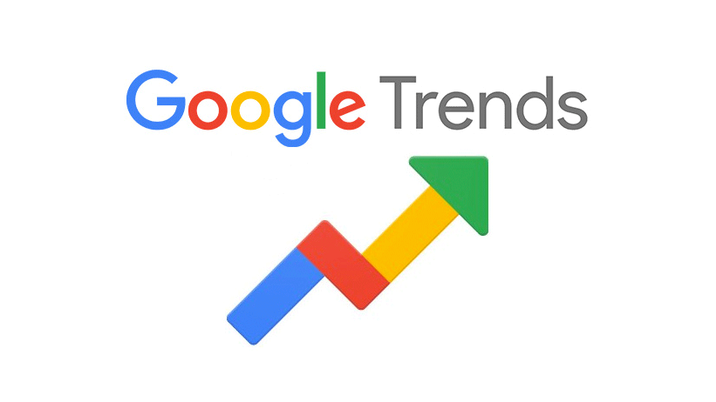


Data & Tools
Data sources
Ingestion
Storage& database
Analysis/Visualization
Prepare
Notes:
- not coin market cap = crypt

Slide 8
Data Source
Data source www.bitinfocharts.com
Description
Number of daily tweets for each cryptocurrency
Time Period
2014-Today
Number of Records
48,598
Data source www.reddit.com
Description
All posts to /r/cryptocurrency subreddit
Total daily subscribers to all cryptocurrency subreddits
Time Period
2014-Today
Number of Records
442,038
121,138
Data source https://trends.google.com
Description
Google trend data
Time Period
2014-Today
Number of Records
120,975
Data source www.cryptocompare.com
Description
Number of daily tweets for each cryptocurrency
Time Period
2009-Today
Number of Records
82,637
Notes:
- not coin market cap = crypt

Slide 9
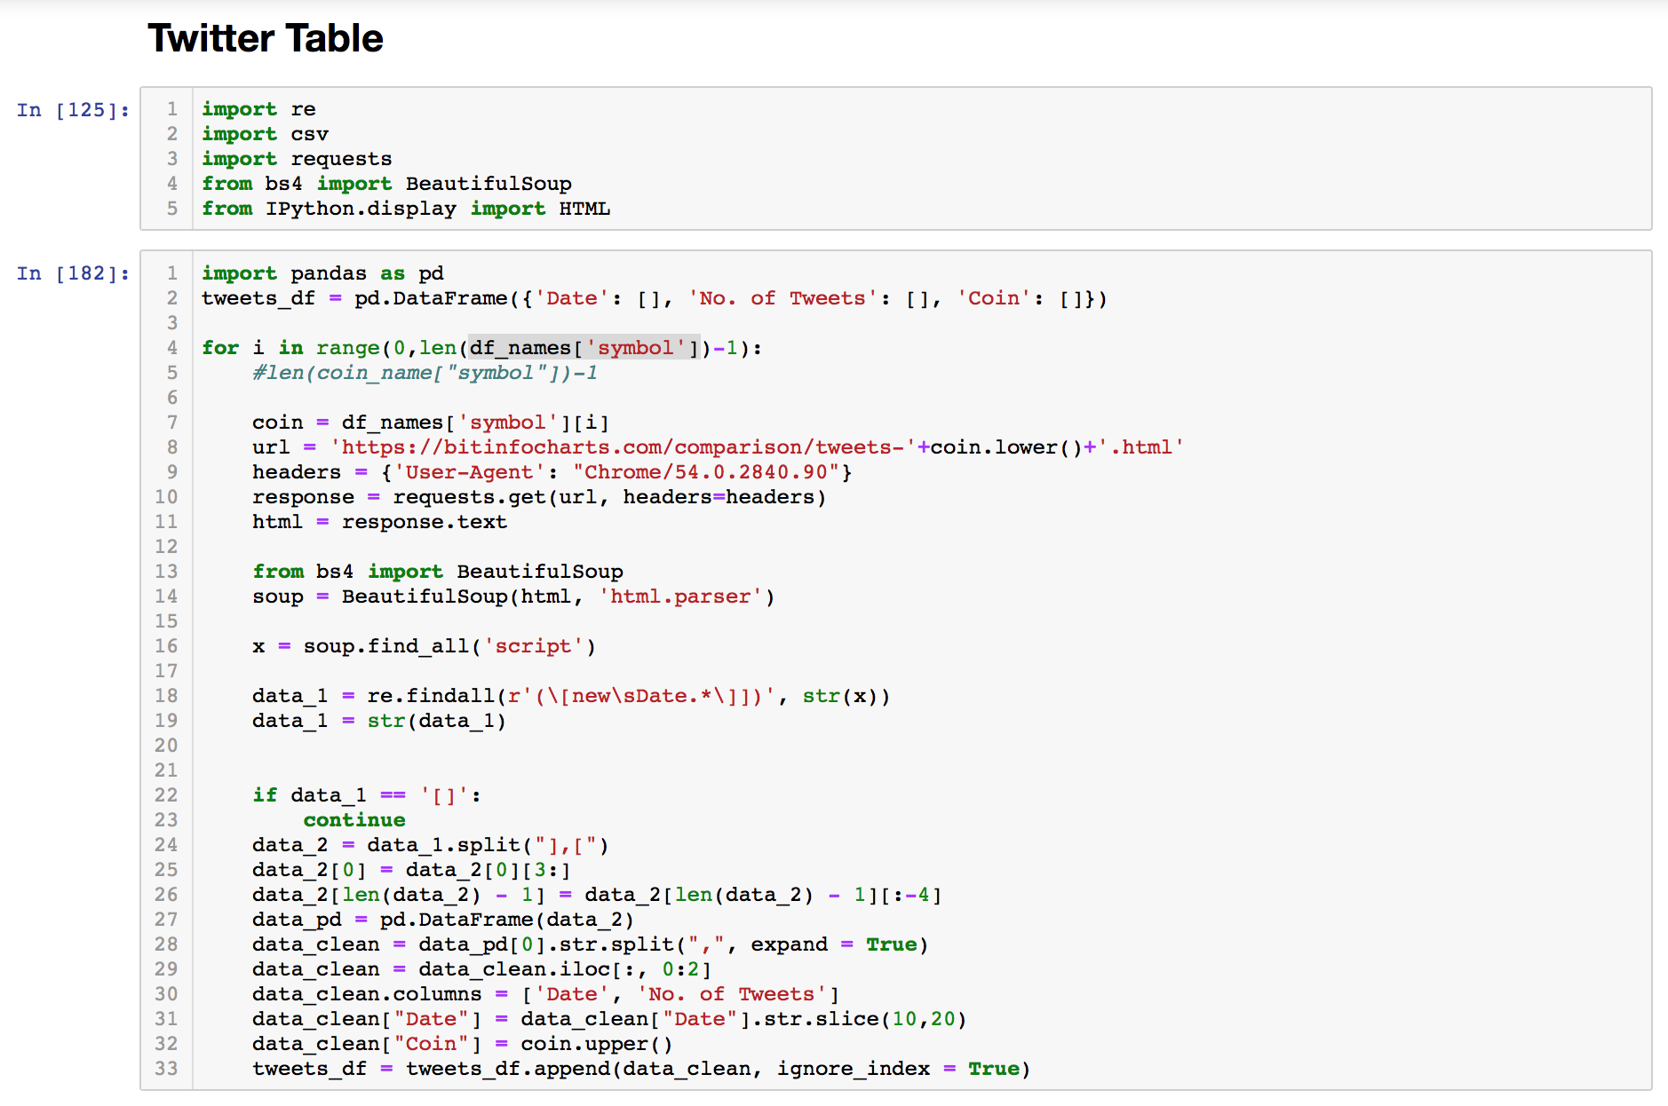
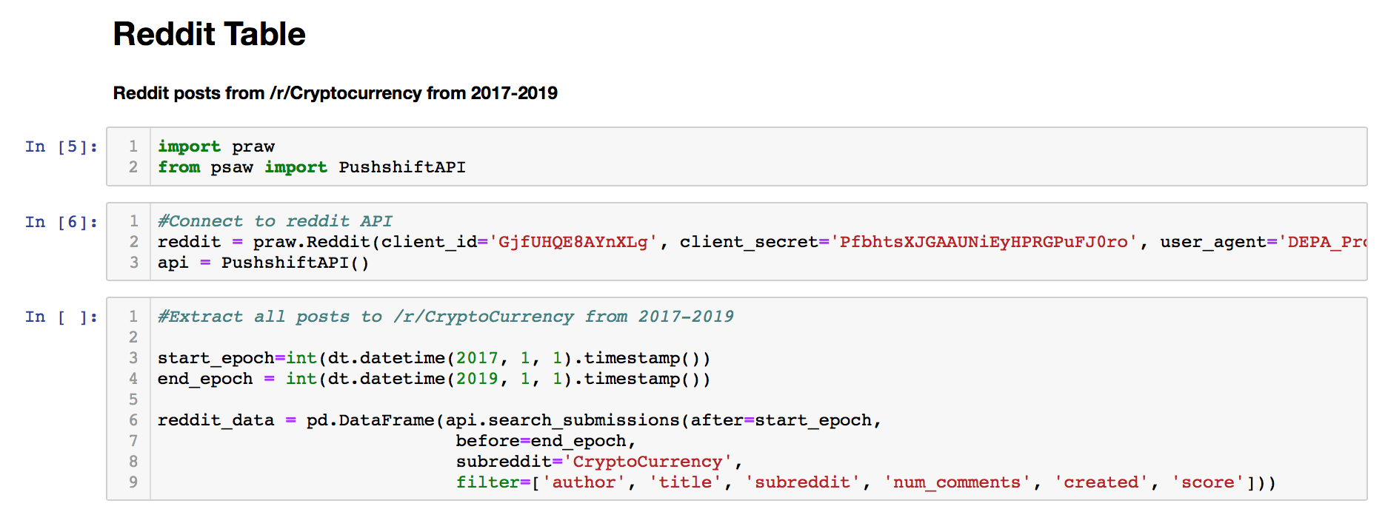
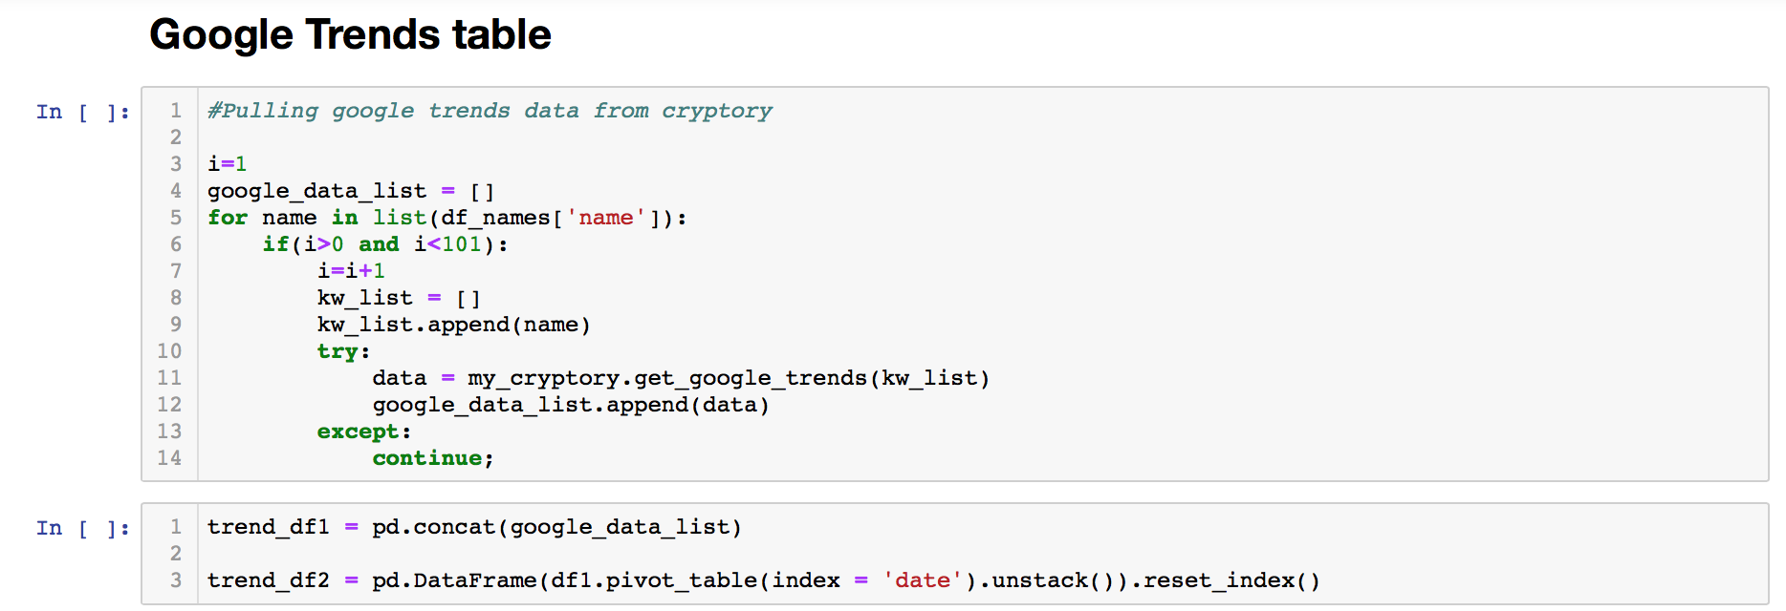
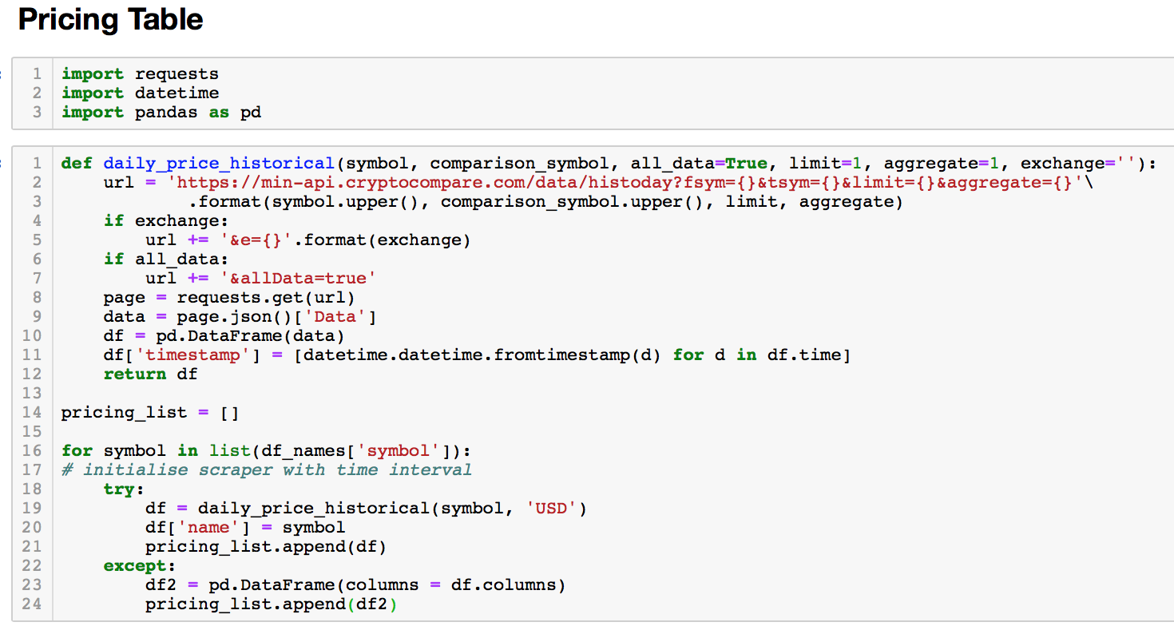
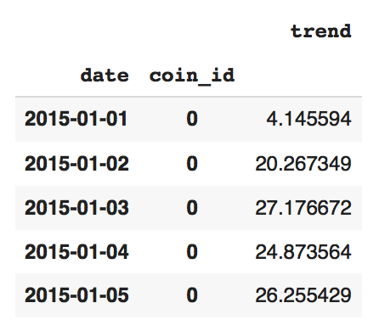
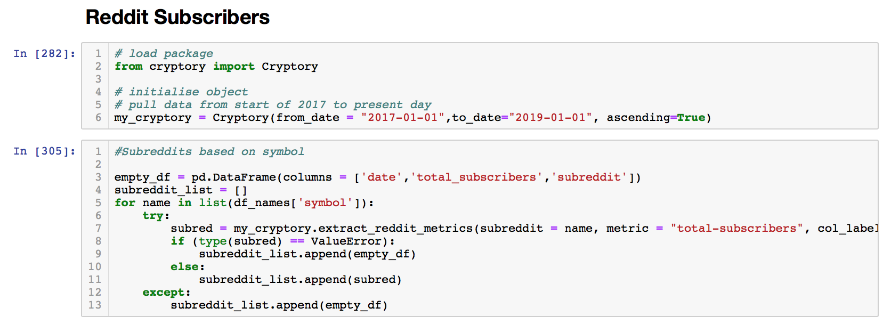
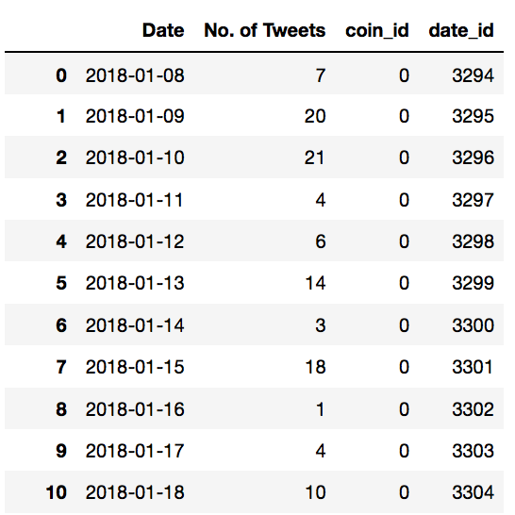
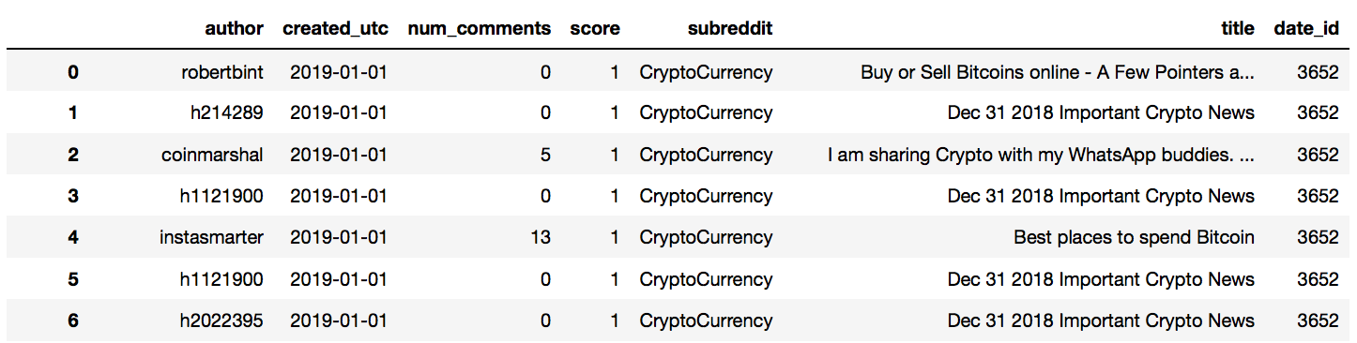
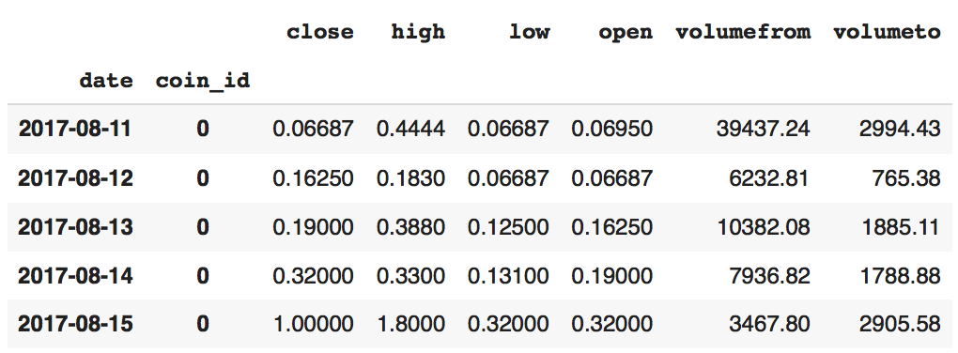
Ingestion
Beautifulsoup API
Scraped # of tweets per currency
Praw & Psaw APIs
Scraped all posts from/r/cryptocurrency
Cryptory API
Scraped google trend data per currency
Cryptocompare api
Scraped pricing data for every currency
Notes:
- not coin market cap = crypt

Slide 10
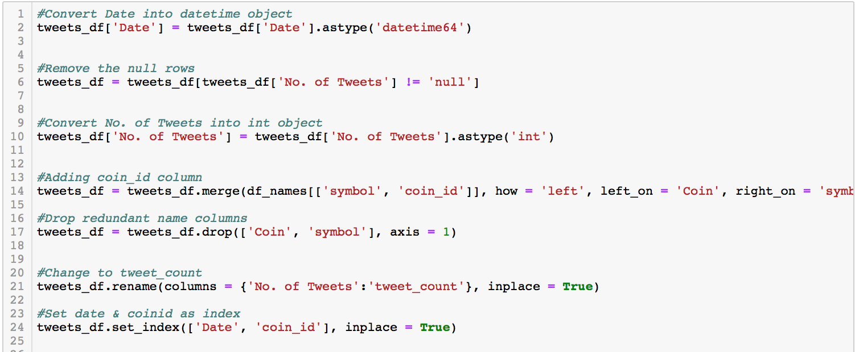
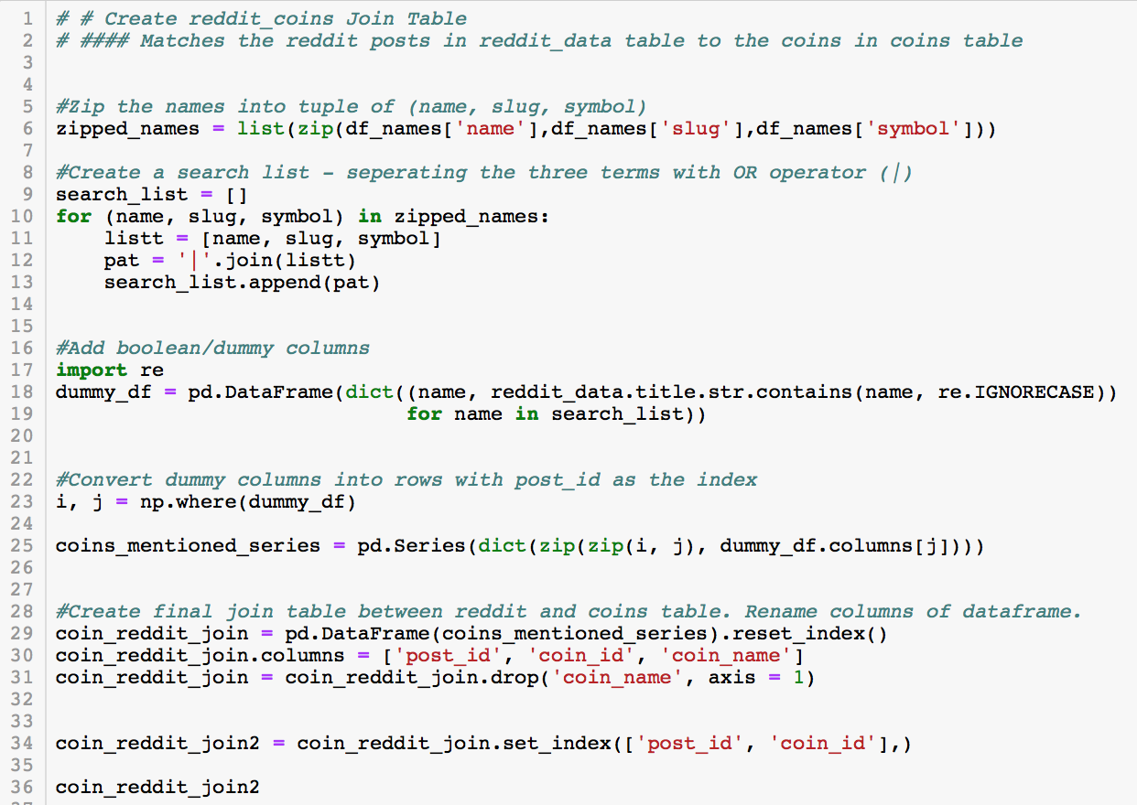
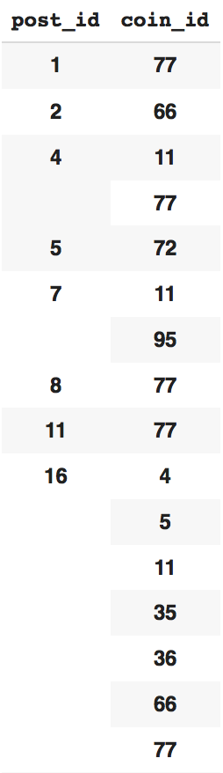
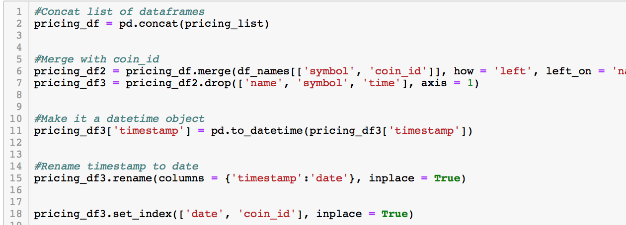
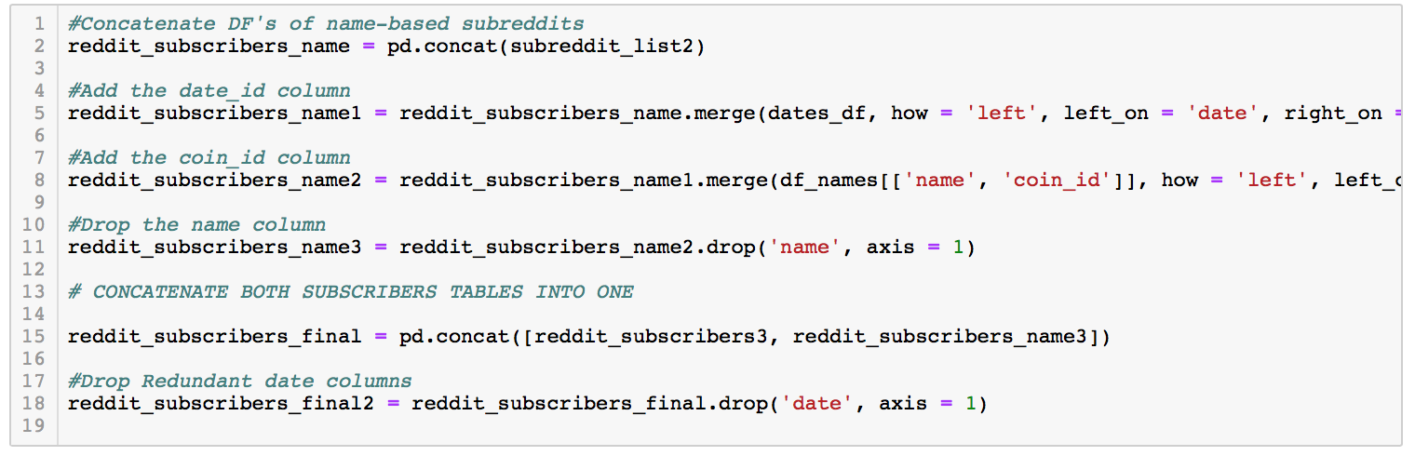
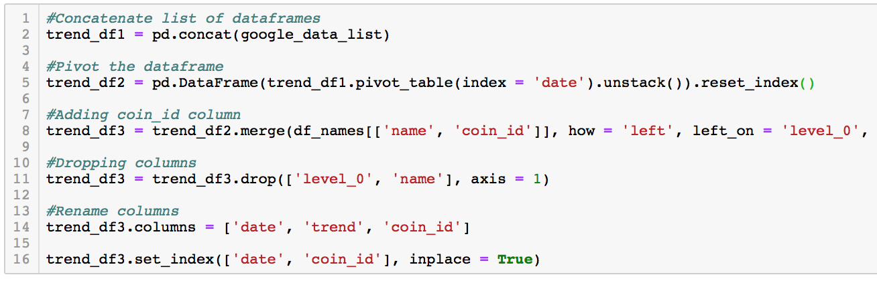
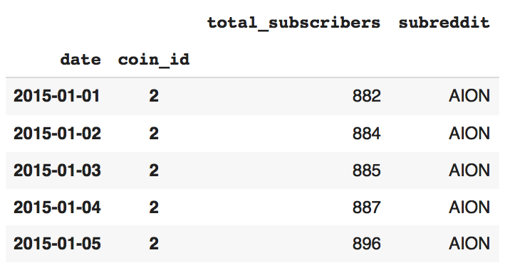
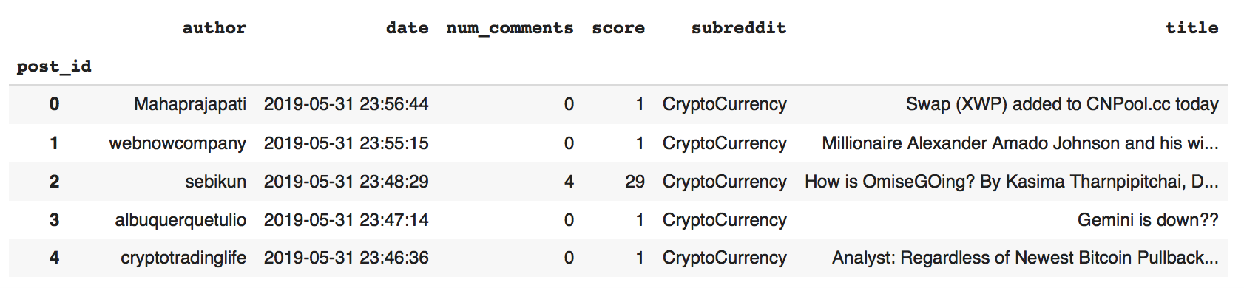
Prepare/Clean
Cleaning Tweets & Merging with coin_id
Creating Reddit-Coin Join Table
Cleaning Reddit Subscribers Table
Notes:
- not coin market cap = crypt

Slide 11
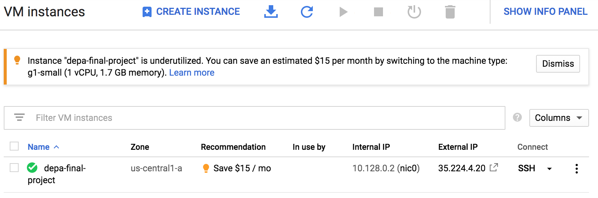
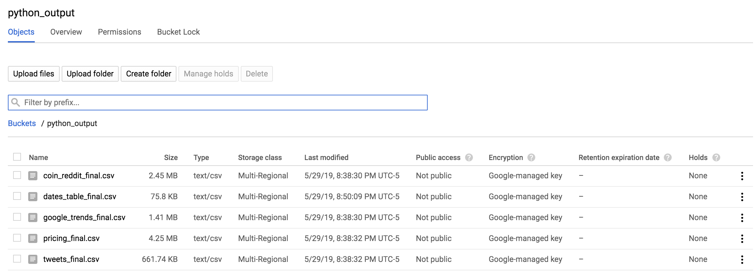
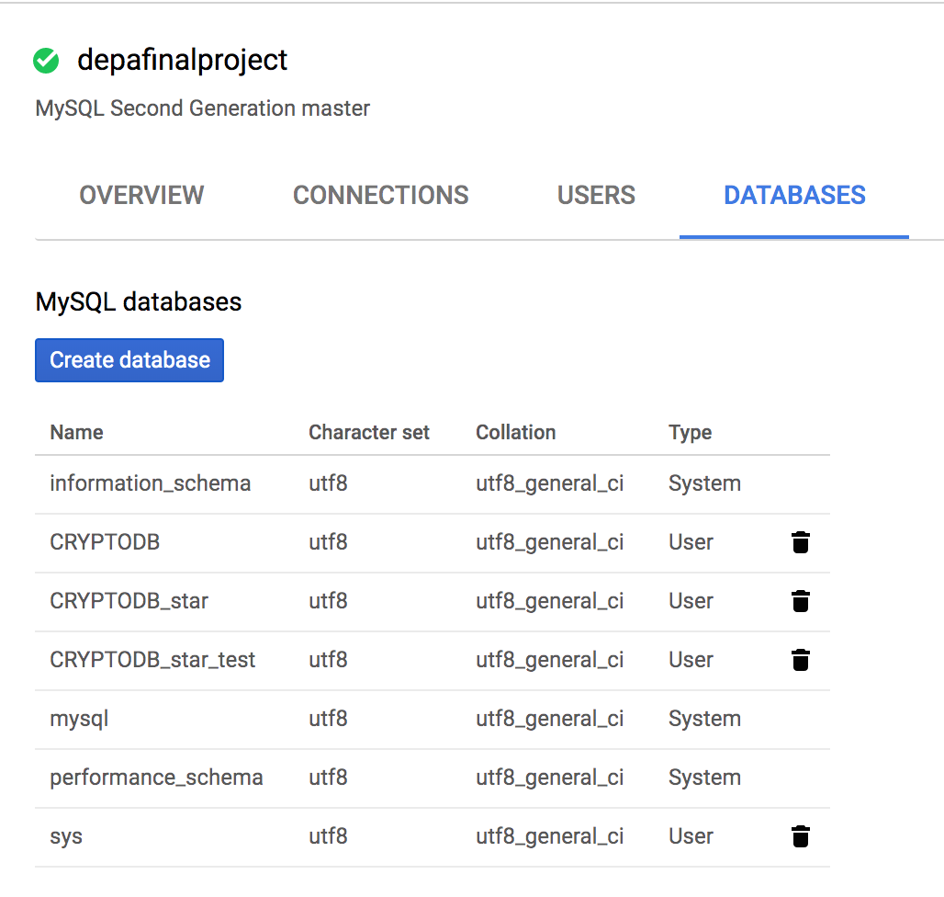
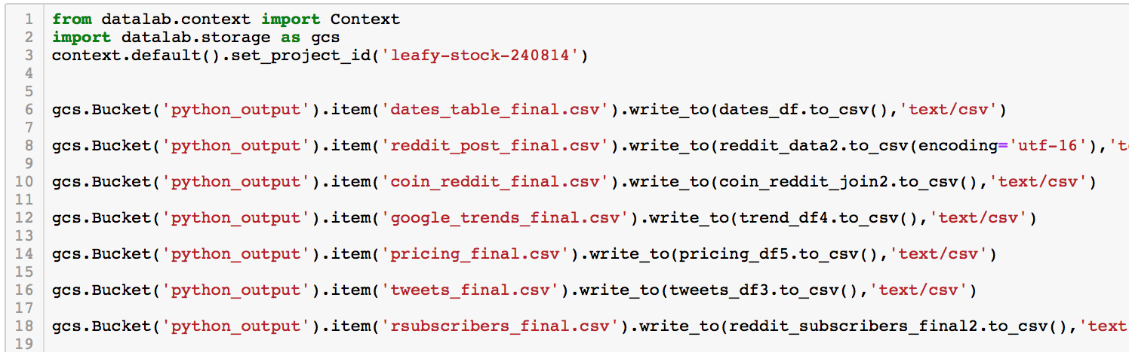
Storage
Compute Engine VM
Storage Buckets
Run all python web scraping and transformation scripts in a VM instance
Import DML/Data from storage bucket csv's
CloudSQL Instance
Store raw data files for potential future use-cases
Store data as .csv files
Run DDL scripts
Create DB through MySQL connection

Slide 12
Database Design Considerations
Requirements
Conceptual
Physical model
Application Type:
Online Analytical Processing for Business Intelligence and end users (OLAP)
Data Format and Size
Cryptocurrency Financial Data
Business Requirements
Optimal user experience
- Elements relevant for pricing model analysis will be stored
- ACID properties used to set constraints, datatypes and ranges of the database
- technical, performance, and process requirements
Hardware and Software
Google Cloud compute and virtual machines, and Google Cloud buckets for storage
- Financial constraints, usability constraints
Notes:
Users
Atomicity − This property states that a transaction must be treated as an atomic unit, that is, either all of its operations are executed or none. There must be no state in a database where a transaction is left partially completed. States should be defined either before the execution of the transaction or after the execution/abortion/failure of the transaction.
Consistency − The database must remain in a consistent state after any transaction. No transaction should have any adverse effect on the data residing in the database. If the database was in a consistent state before the execution of a transaction, it must remain consistent after the execution of the transaction as well.
Durability − The database should be durable enough to hold all its latest updates even if the system fails or restarts. If a transaction updates a chunk of data in a database and commits, then the database will hold the modified data. If a transaction commits but the system fails before the data could be written on to the disk, then that data will be updated once the system springs back into action.
Isolation − In a database system where more than one transaction are being executed simultaneously and in parallel, the property of isolation states that all the transactions will be carried out and executed as if it is the only transaction in the system. No transaction will affect the existence of any other transaction.

Slide 13
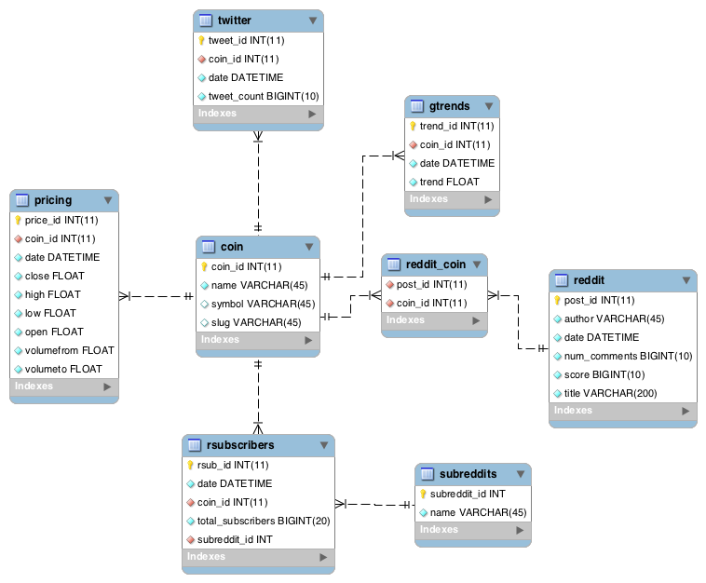
Enhanced Entity Relationship Diagram
Entities:
reddit: /r/cryptocurrency sub post data
reddit_subs: subscriber count for >150 coin subreddits
Pricing: cryptocurrency market OHLCV data
Twitter: tweet count by coin mentioned
gtrends: Google trend data by coin
reddit_Coin: join-table linking reddit post data to coin ID
date : date information
Relationship & Cardinality
Normalization Achieved:
No functional dependencies
No transitive dependencies

Slide 14
Enhanced Entity Relationship Diagram
Entities:
reddit: /r/cryptocurrency subreddit post data
rsubscribers: subscriber count for over 150 coin subreddits
pricing: cryptocurrency market OHLCV data
twitter: tweet count by coin mentioned
gtrends: Google trend data by coin
reddit_coin: join-table linking reddit post data to coin data
subreddits: name of subreddit and subreddit id
coin: coin information containing coin names
Normalized Data:
No functional dependencies
No transitive dependencies
Notes:
Relationship & Cardinality
- OHLCV – open high low close volume

Slide 15
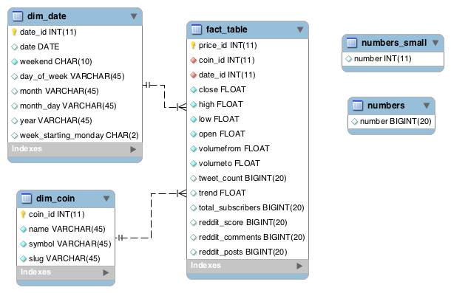
Dimensional Model (Star Schema)
4 Step Dimensional Design Process
Business Process
Trader/User-oriented
Grain
Currency-date level detail
Dimensions
Determined by grain statement
Facts
Social media aggregates
Balancing user requirements with data realities
Notes:
- add screenshots of mysql

Slide 16


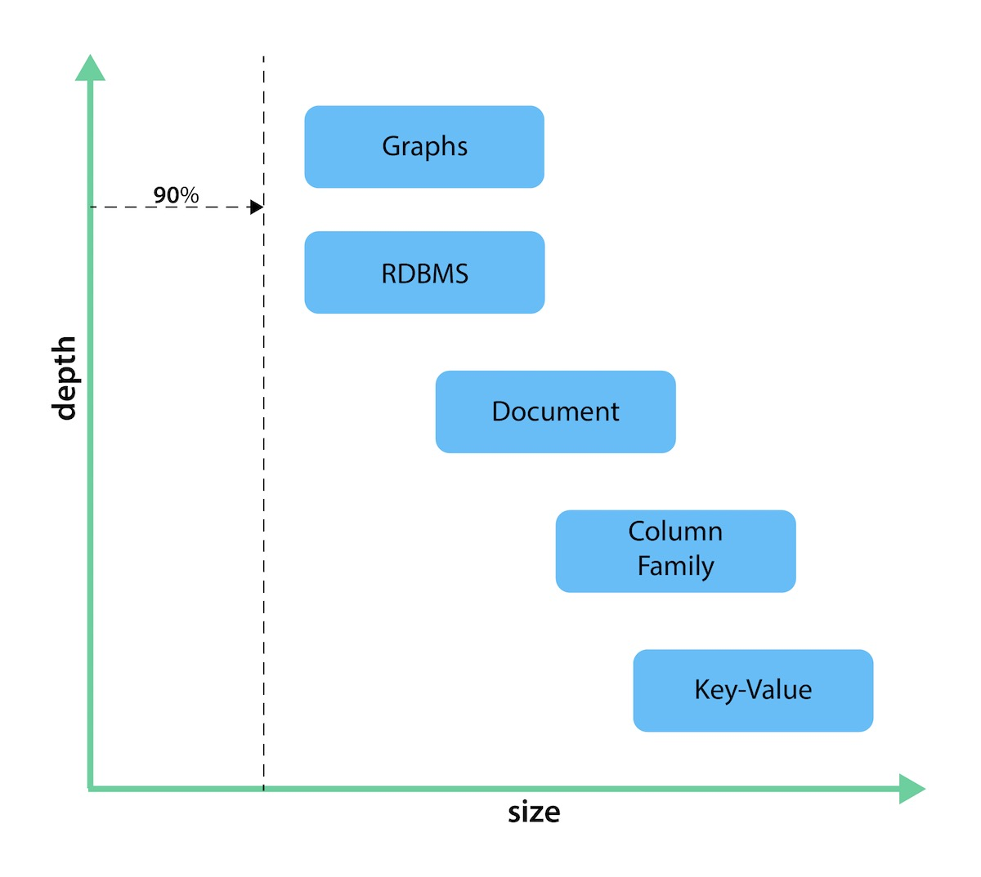
NoSQL and Graph Databases
Non-relational databases like MongoDB do not follow ACID properties
"almost SQL" languages are inappropriate for SQL "joins" and similar functionality
Inappropriate Language
Use speed plummets as the amount of data increases and the number of join keys grows
Degraded Performance
MongoDB cannot model or store relationships if no complexity exists
Inappropriate Model
Our datasets are sourced through webscraping methods via APIs
Not ACID
Inappropriate database
Graph databases are inappropriate for traditional relational data.
Not efficient for high volumes of transactions
Graph databases are not as useful for operational use cases since they are not good at handling large queries that span the entire database.
Not an independent master data management solution
A graph database is just a data store and doesn't give you a business-facing user interface to query or manage relationships.
It will not provide advanced match and survivorship functionality or data quality capabilities.
Difficult to perform mass analytics queries across all the relationships and records.
Notes:
For our particular database, we decided not use MongoDB.
Relational Databases cannot handle non-relational data
Our datasets are sourced through webscraping methods via APIs
Inappropriate Model
MongoDB cannot model or store relationships if no complexity exists
Degraded Performance
Use speed plummets as the amount of data increases and the number of join keys grows
Inappropriate Language
"almost SQL" languages are inappropriate for SQL "joins" and similar functionality
Not ACID
Predictable
Clean
Normalized
Not join intensive
The chart below shows how each database type stacks up on a spectrum measuring depth and size. While key-value stores can handle massive sizes, they are designed for a high-level view (low depth) of the data. Graph databases retain minimum sizing, even at a greater depth of data than other types of databases. The other types of databases fall somewhere in between those ranges.

Slide 17
Graph Databases/ Neo4j
Inappropriate database
Graph databases are inappropriate for traditional relational data.
Not efficient for high volumes of transactions
Graph databases are not as useful for operational use cases since they are not good at handling large queries that span the entire database.
Not an independent master data management solution
A graph database is just a data store and doesn't give you a business-facing user interface to query or manage relationships.
It will not provide advanced match and survivorship functionality or data quality capabilities.
Difficult to perform mass analytics queries across all the relationships and records.
For our particular database, we also decided not to use Neo4j for the following reasons:
Notes:
- Graph databases are not as useful for operational use cases because they are not efficient at processing high volumes of transactions and they are not good at handling queries that span the entire database.
- https://tdwi.org/articles/2017/03/14/good-bad-and-hype-about-graph-databases-for-mdm.aspx
The chart below shows how each database type stacks up on a spectrum measuring depth and size. While key-value stores can handle massive sizes, they are designed for a high-level view (low depth) of the data. Graph databases retain minimum sizing, even at a greater depth of data than other types of databases. The other types of databases fall somewhere in between those ranges.
https://neo4j.com/developer/graph-db-vs-nosql/

Slide 18
Analysis/Visualization

Slide 19
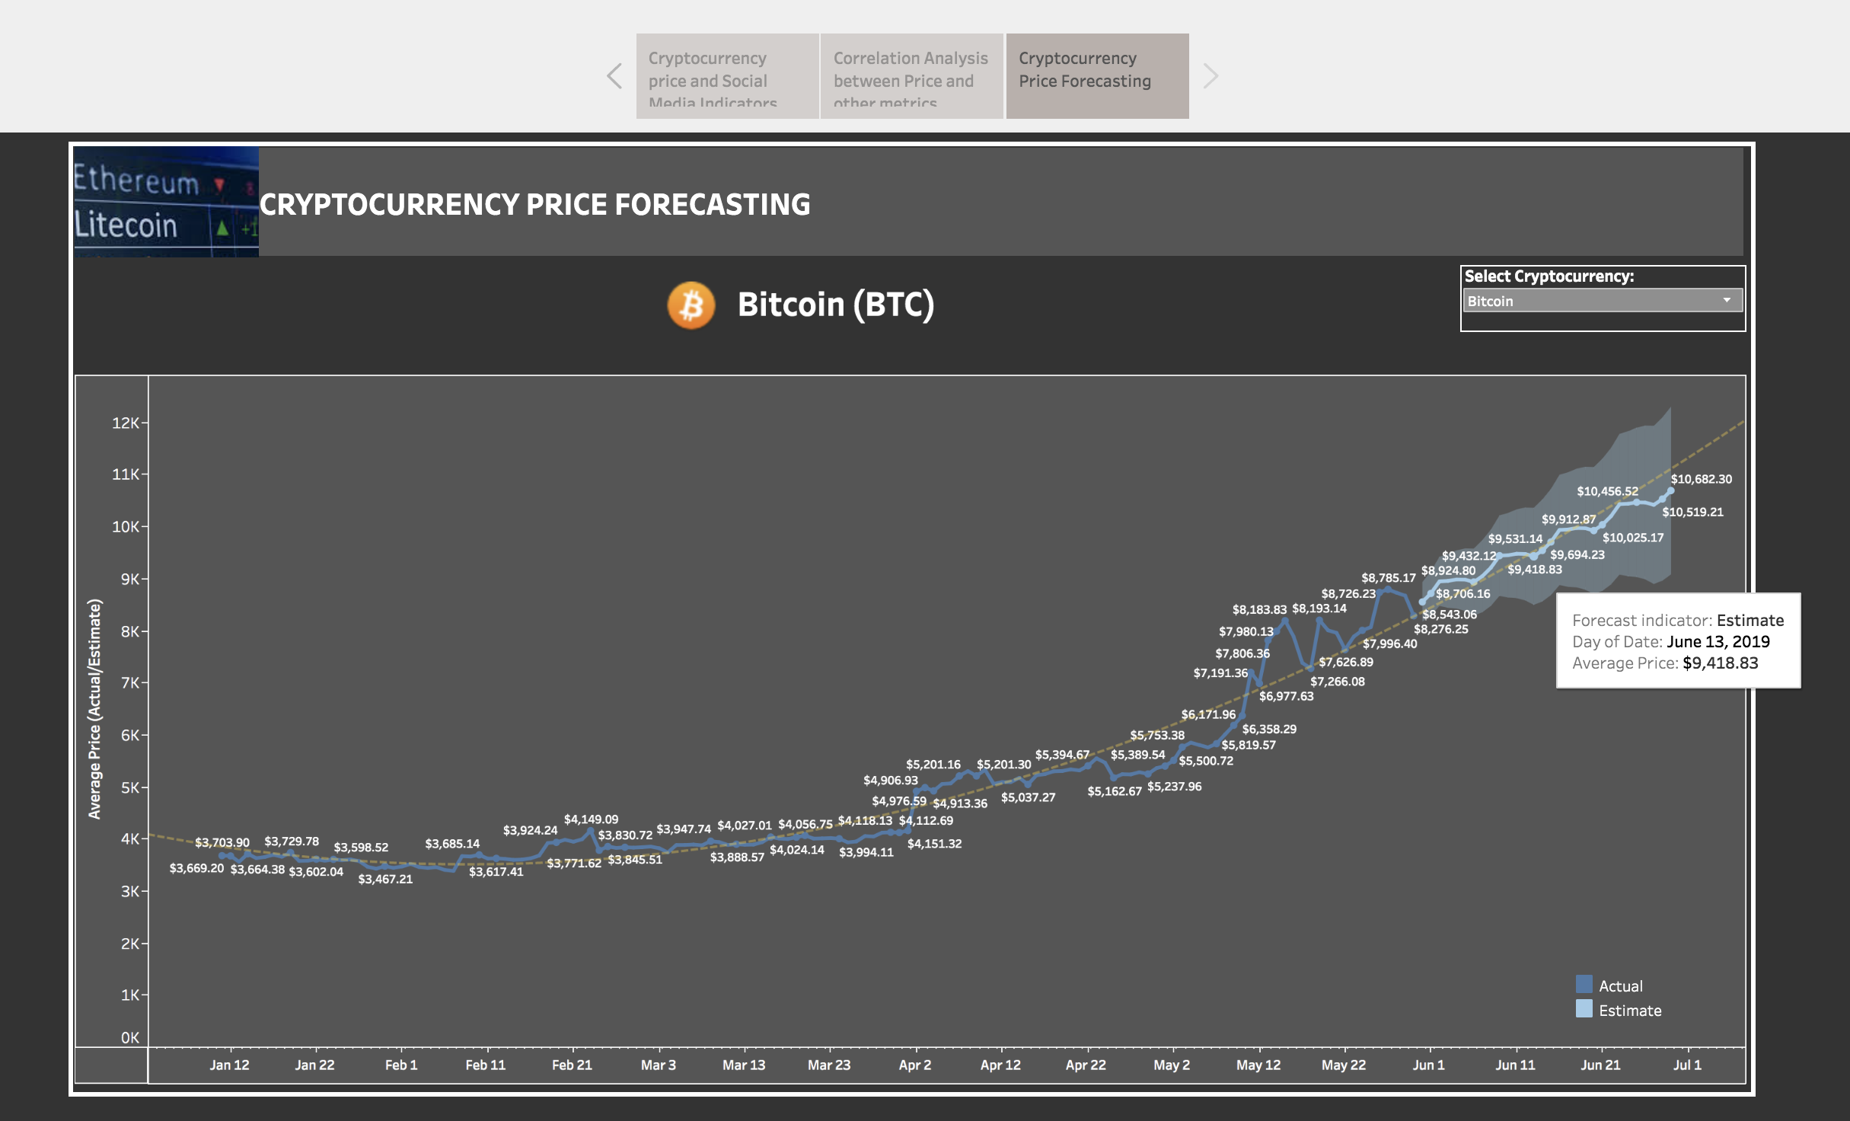
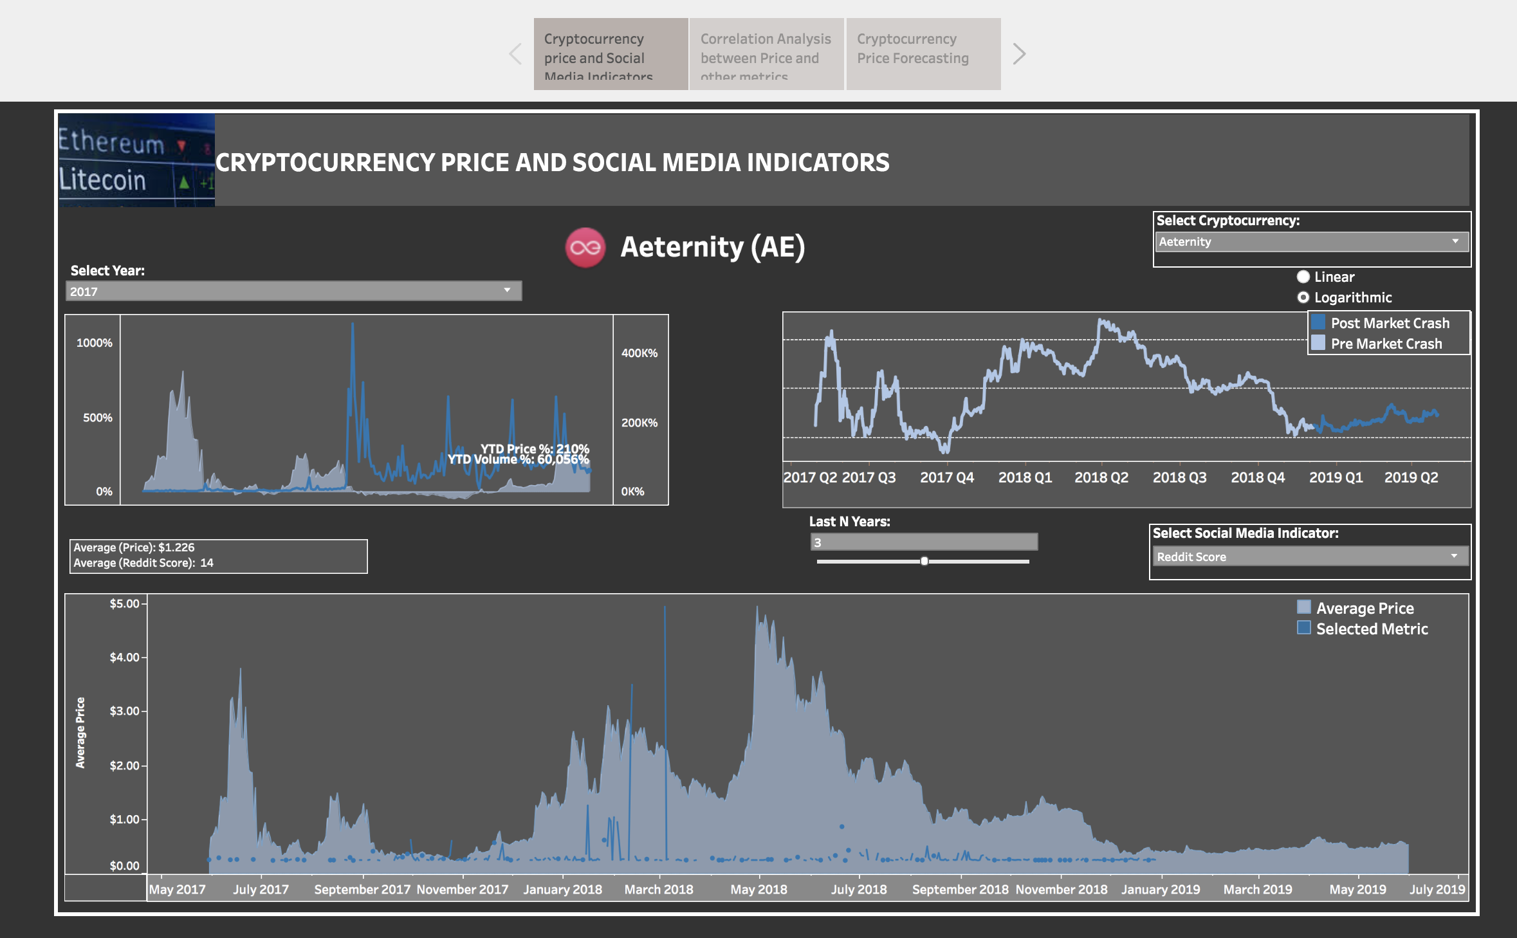
Analysis/Visualization

Slide 20
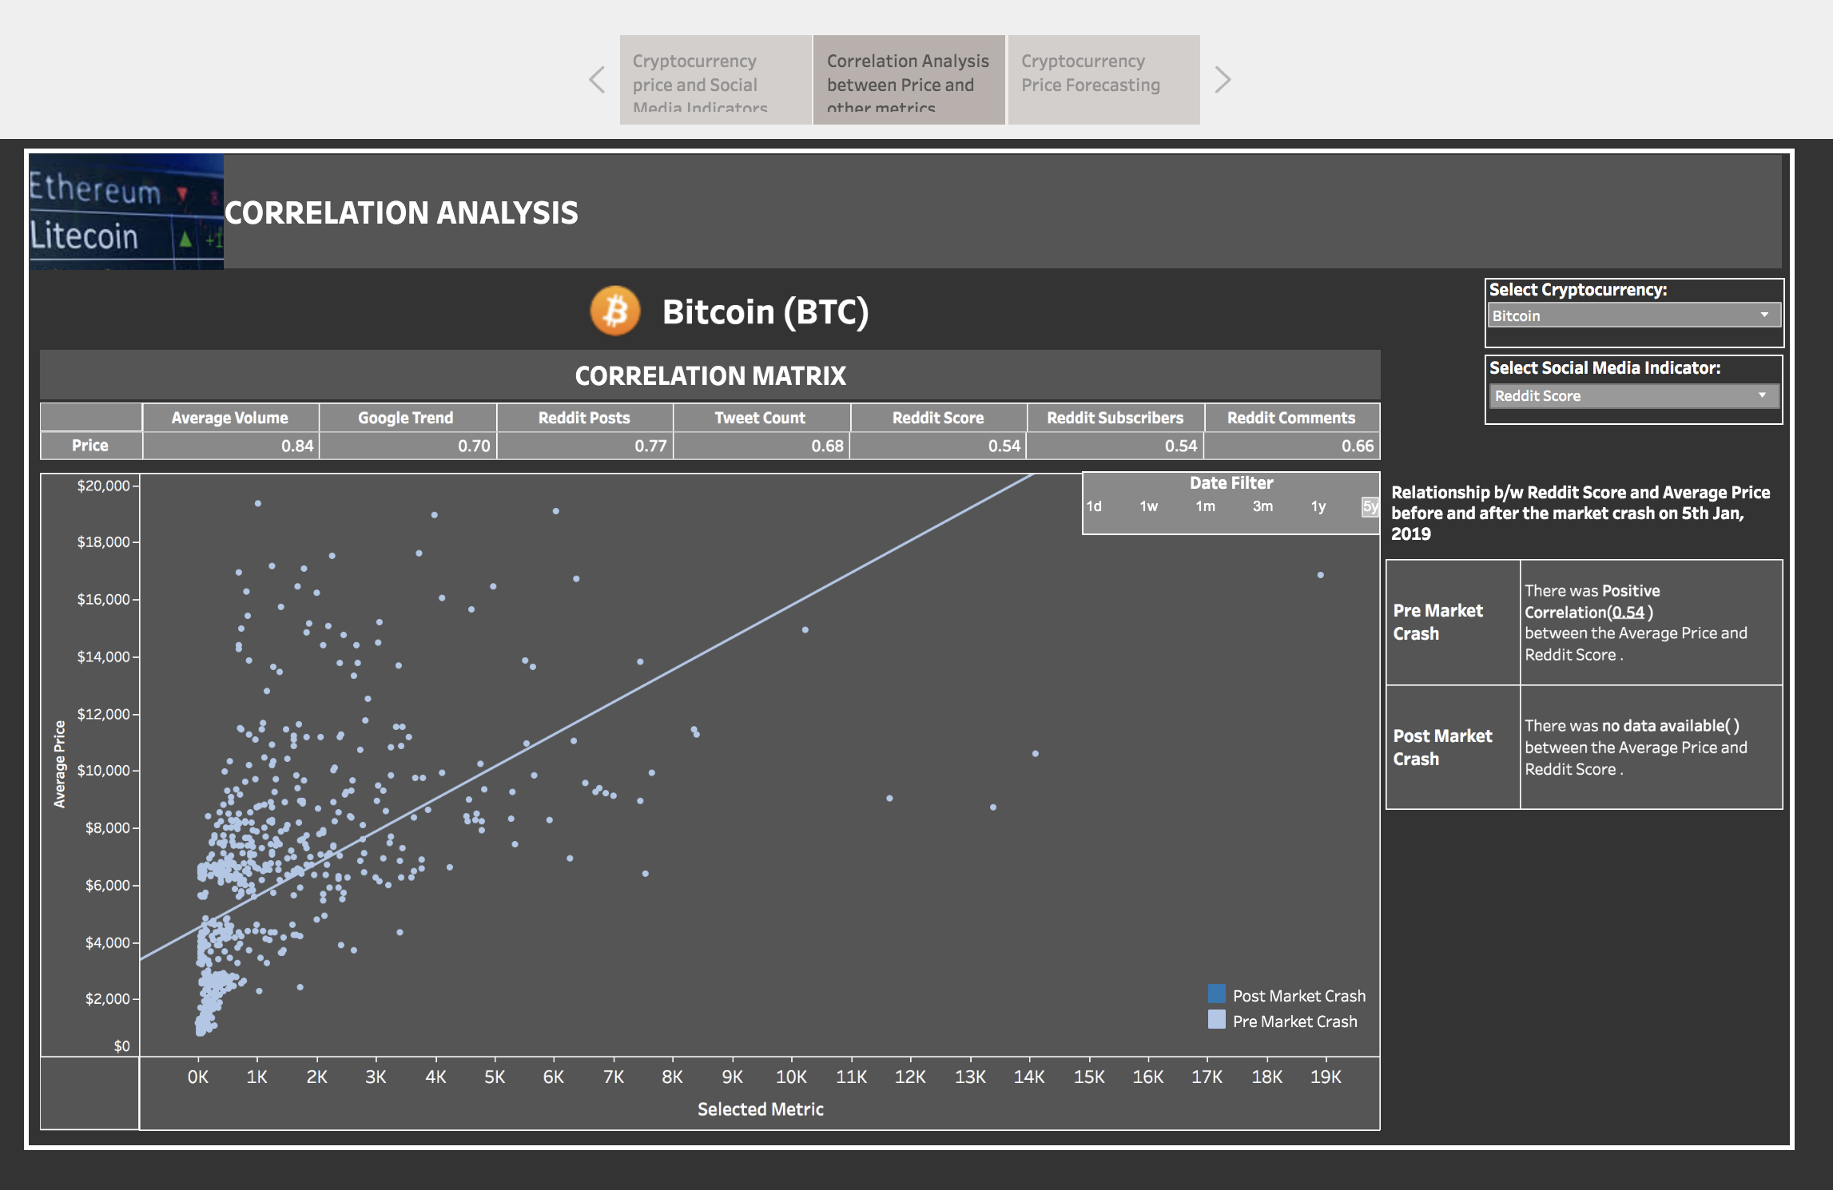
Analysis/Visualization
Interactive Demo: Tableau Public Website

Slide 21
Future Work & Corrective Measures
*by twitter users by region
*predictive model
*deployment
*actual NLP on twitter and github/reddit post
*include additional market data (market cap, circulating supply, spread, etc.)
Revisit dimensional design process and level of granularity (more granular)

Slide 22
Conclusion
Through this project we:
Created a database that

Slide 23
APPENDIX

Slide 24




Summary of Data Analysis Pipeline
Ingest & Extract
Prepare & Clean
Store & Organize
Analyze & Process
Visualize & Explore

Slide 25
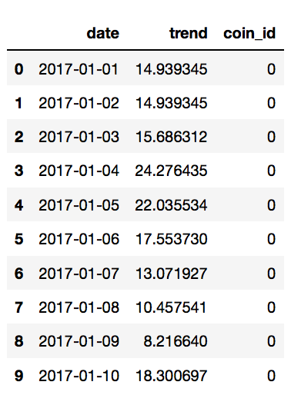
Data Extraction and Web Scraping
Reddit
Praw/psaw API
Scraped all reddit posts from/r/cryptocurrency for our timeframe of 2 years
Twitter
Beautifulsoup API
Google Trends
Cryptory API
Scraped google trend data for every currency in our timeframe of interest
Scraped # of tweets per currency. Granularity at the day level

Slide 26
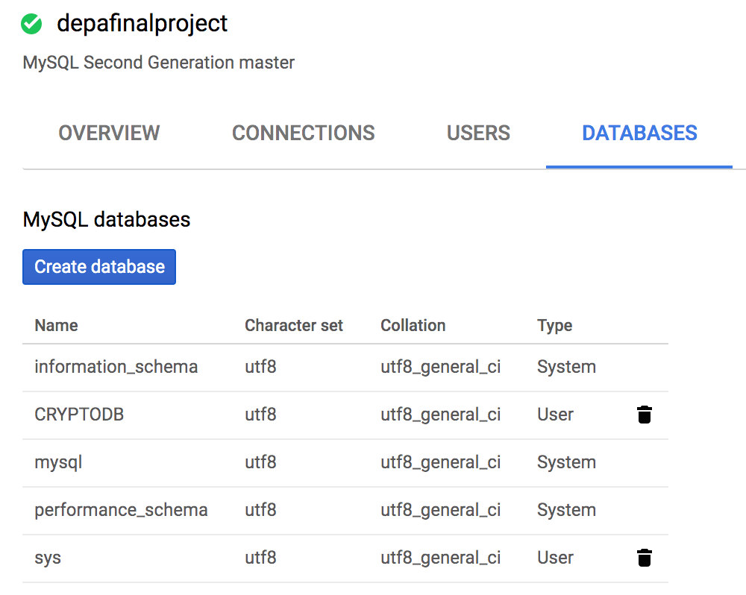
Data Storage
Compute Engine VM
Push data to buckets
Storage Buckets
Transform and normalize tables
Run all webscraping scripts in python 3
Import DML/Data from storage bucket csv's
CloudSQL Instance
Store raw data files for potential future use-cases
Store data as .csv files
Run DDL scripts
Cryptodb Database created through MySQL connection

